Slide 1


Sagar Institute of Science, Technology & Engineering,
Ratibad Campus, Bhopal (M.P.)
Problem Statement Title: Video metadata generation and classification
PS Number: SS585
Organization Name: Department of Space, Indian Space Research Organization (ISRO).
Team Members:
Neeraj Singh
Yogendra Singh
Bhuvaneshwar Vishwakarma
Muskan Sharma
Vikas Kumar Pandey
Ankush Parihar
Guided by:
Dr. Rahul Shrivastava
Department of Computer Science & Engineering

Slide 2
Problem Description
ISRO has large amount of videos with various categories, that needs to be analyse, but they can’t do manually one by one, So they need automated software that can help them to categories videos in a various categories and create a metadata of videos .

Slide 3
Metadata
Metadata is “data about data”.
Video metadata is basically the data about a video. Video meta data will have the information of the category of the video, like the given video is an interview video or a satellite video, or a Satellite launching video, or a control room Video.
Furthermore, a meta data may be the descriptive summary of the video, for example: a meta data for the satellite launching video may have the details like “the video is about the launching of XYZ satellite by GSLV”, for an interview video, the descriptive summary can be like “ XYZ person said that ISRO is planning for mars mission on XYZ date”
Moreover, a meta data can be like , length of the video in time.

Slide 4
Porposed Mechanism
Video frames
CNN for video classification
Top Three Categories of video
Input Video File
Video file
Common Category of video
Audio file
Audio to text convertor
Deep LSTM neural network based Text Summarization
NLP Model For video classification based on text
output
Metadata
Category of the video

Slide 5
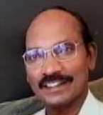
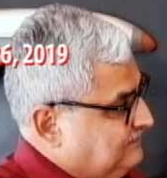
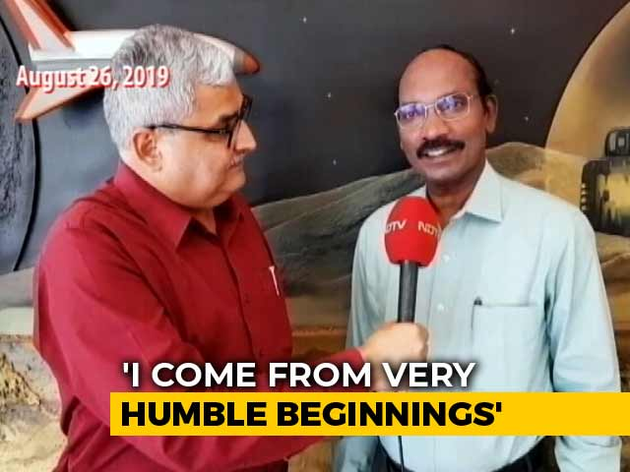


Proposed Mechanism to convert role entity bindings
to natural language sentence
Cropping the face from the input video frame using the face coordinates
Face Detection
Person
Y
Extracted body parts coordinates
(body1)
Input video
Proposed model
for the recognition of entity’s role, and object body relation
Who has given interview
Person
X
OpenCV to Extract 3D Body Coordinates
+
Who has taken interview
+
Extracted body
parts coordinates
(body2)
Role Entity bindings to natural language convertor
<Person X
-Who has given interview>,
<Person Y -Who has taken interview
Yolo for object detection
Real time CCTV Video
In this video, Person X has taken interview of Director ISRO K Siwan

Slide 6

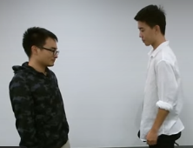
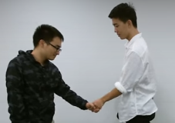

Proposed Mechanism to recognize the role of each individual entity
Spatial Temporal Memory for Role Recognition
Intra Body Point Distances
Role
Recognized Activity
Extracted Body Angles
(context)
Angle Correlation
Spatial Temporal Memory for Activity Recognition
X Box
Extracted body joints
of person1
Inter body Distances
Extracted Body Angles
Sequence of Image frames
Recognized Activity
(context)
Extracted body joints
of person 2
Spatial Temporal Memory for Role Detection
Role
Intra Body Point Distances

Slide 7
Thank You

